Slide 1
Finding Underrepresented Voices: Using Social Media as an Information Source in IL Instruction

Slide 2
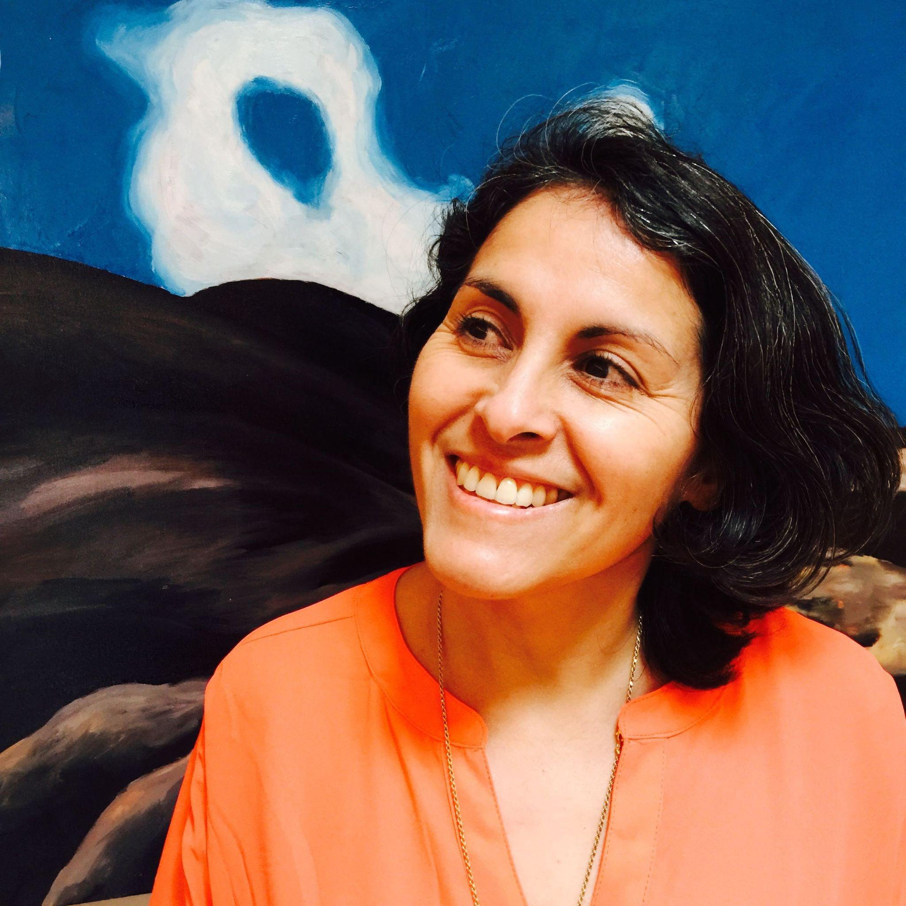
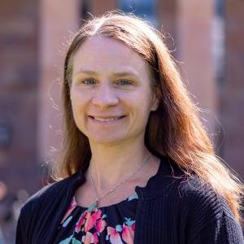
Hello!
Kathia Ibacache
Elizabeth Novosel
You can find us:
https://www.colorado.edu/libraries/kathia-ibacache
https://www.colorado.edu/libraries/liz-novosel

Slide 3
Our presentation explores the inclusion of voices and resources not traditionally represented in the scholarly literature in academic work.
We suggest that social media could be utilized as a source of information in library instruction sessions to connect students with underrepresented voices.

Slide 4
According to a 2021 Pew Research report…
More than 80% of 18 to 29-year-olds use social media
Research shows that students in higher education use social media for academic purposes

Slide 5
Our Goals:
During our time together, we would like you…
…to consider how you could use social media as a research tool to access different perspectives and voices in IL instruction.
…to understand some of the benefits and challenges of information found in social media related to the broad range of voices and opinions available on platforms.
…to consider the usefulness of hashtags to cover subject headings in IL instruction as well as social media’s ability to engage students in the research process.

Slide 6
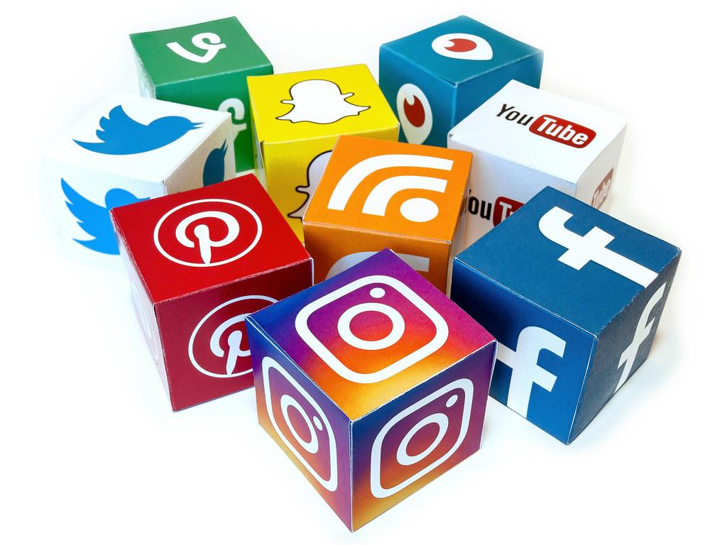
We Define Social Media As:
“...a group of Internet-based applications that build on the ideological and technological foundations of Web 2.0, and that allow the creation and exchange of User Generated Content.”
(Kaplan and Haenlein, 2010)
Image taken from Flickr, used under the Creative Commons license CC BY 2.0.
Andreas M. Kaplan and Michael Haenlein, “Users of the World, Unite! The Challenges and Opportunities of Social Media,” Business Horizons 53, no. 1 (2010): 61, https://doi.org/10.1016/j.bushor.2009.09.003.

Slide 7
In our project, we define “Information Source” as…
…a primary or secondary resource used for academic research or assignments in a higher education setting.

Slide 8
Activity
Possible search ideas:
Pinar Sinopoulos-Lloyd, Queer Nature
Quannah Chasinghorse, Indigenous rights
Rachel E. Cargle, anti-racism teacher
Peppermint, Black Trans Lives Matter
Judith Heumann, Disability Advocate
Sustainable Agriculture
Save the Rhinos
1. Go to Twitter.
2. Enter the name of an activist, organization or educational/governmental institution.
What do you see?
JAMBOARD: https://tinyurl.com/3wksm97m

Slide 9
Findings from Our Study

Slide 10
Respondents Demographics
Most worked in a university that confers doctoral degrees.
The largest percentage of librarians who used social media identifies their job as involving “outreach.”
Large representation of subject specialists.
A smaller percentage of librarians who categorized their positions as instruction and reference said they used social media.

Slide 11
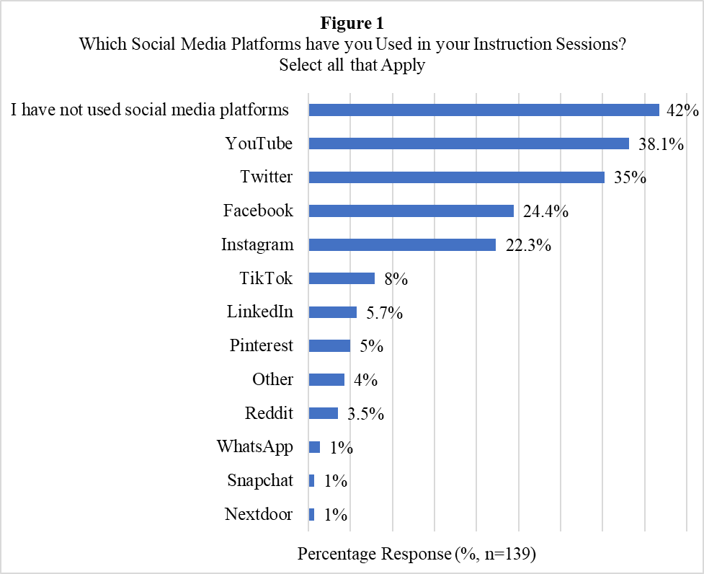

Slide 12
The Most Common Uses of Platforms n=81
Evaluation skills 44%
Teaching the platform 43%
Lessons on citing and
fair use 44%
To teach what is available on platforms 47%
Show relevant example 42%
Reference the platform without demonstration 41%
Showing how to find authoritative sources 36%
Teach lessons on fake news 35%

Slide 13
The Most Utilized Platforms
#1
#2
#3
Twitter
YouTube
FaceBook
Evaluation skills
Lessons on fake news
What information is available on social media
How to find news and current events
Lessons on citation
How to find resources posted by scholarly sources
Often used as a reference
Respondents did not demonstrate or use it in instruction

Slide 14
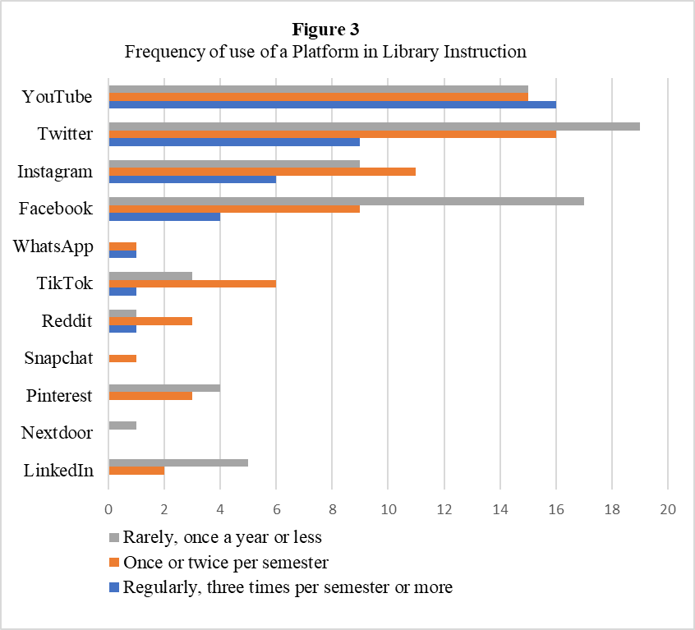
Platform Frequency of Use in IL Instruction

Slide 15
Top Benefits and Challenges of Using Social Media in IL Instruction
Too many things to teach (36%)
Student Familiarity (55%)
Technology changes fast (26%)
Access to voices not represented in academic sources (41%)
Privacy issues for students (24%)
Unreliable Information (19%)
Social media skills are important for everyday life (27%)
Benefits
Challenges
N = 92
N = 107
Student lack of accounts (19%)
Social media provides current information (21%)
Privacy issues for myself (14%)
My technical skills (10%)
Social media keeps me up to date with technology (17%)
Students become distracted (8%)

Slide 16
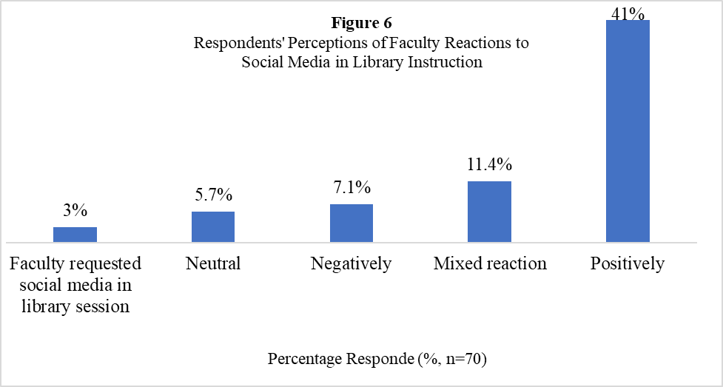
Perceptions of Faculty Reactions to Social Media in IL Instruction

Slide 17
Discussion
We would like to hear about your experiences!
How do you think social media could be used as a resource in IL instruction?
JAMBOARD: https://tinyurl.com/3wksm97m

Slide 18
Conclusions
Despite challenges, social media could be a:
Venue for students to connect with underrepresented voices
Medium for people to participate in global conversations
Teaching librarians could engage in discussions and visualize ways to approach social media in IL instruction more effectively

Slide 19
Any questions?

Slide 20
Thank you!
Kathia Ibacache Romance Languages Librarian
Elizabeth Novosel Faculty Fellow • Liaison & Projects Librarian
You can find us:
https://www.colorado.edu/libraries/kathia-ibacache
https://www.colorado.edu/libraries/liz-novosel

